Slide 1
“Watch out for that Phish!”
BRIAN BAUTISTA
Information Security Engineer
Division of Information Technology | Creighton University

Slide 2
Agenda
Phishing Emails
What are phishing emails
Why do attackers use phishing emails
Types of phishing attacks
How to spot phishing emails
What to do if you think you received a phishing email
Creighton University moving to Microsoft Email Protection
Junk E-mail
Quarantine E-mail
Microsoft Authenticator App Update
Number matching
Information Security

Slide 3
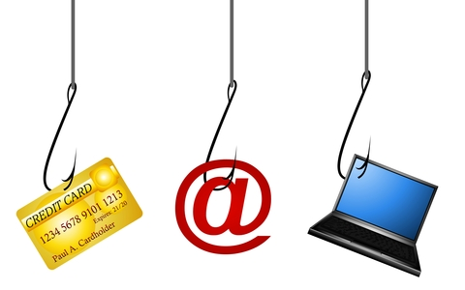
Phishing Emails
The sending of malicious emails which are designed to trick the user into falling for a scam.
The Purpose is to get the user to provide personal information such as passwords, credit card numbers or other sensitive data.
Information Security

Slide 4
Why attackers use email?
User Trust: users tend to consume large amounts of email quickly without bothering who the sender is, what message content looks like, and the links or attachments associated with the email.
Inexpensive: with little effort and cost, email addresses can easily be created and send large amount of emails quickly to users.
Information Security

Slide 5
Types of Phishing Emails
Phishing: typical email message sent to large group pretending to be a legitimate service for the purpose of gaining personal identifiable information (PII).
Malware: message with links or attachments that contain malware. The malware is downloaded and executed on the computer. Ransomware and keyloggers are common malware attachments
Spear phishing: message sent to specific users within organization to trick them in giving up sensitive data. This may include HR, financial departments or high-privilege account holders.
Account Takeover: message used to obtain university credentials by spoofing Creighton email addresses or fake login pages.
Information Security

Slide 6
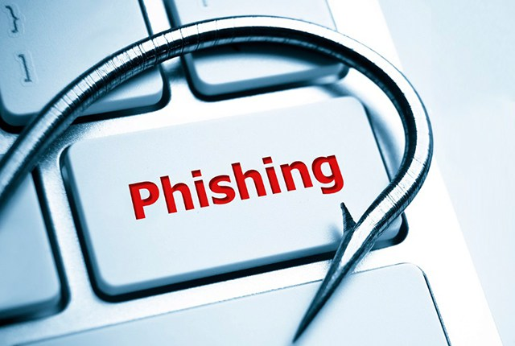
How to spot Phishing emails?
Sense of Urgency: unrealistic threats to click a link or update account information immediately.
Information Security

Slide 7
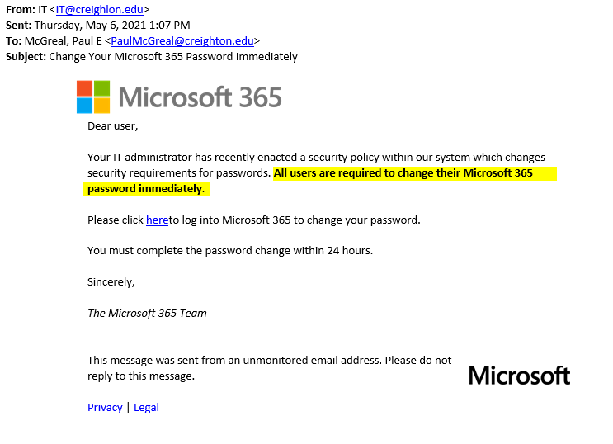
How to spot Phishing emails?
Information Security

Slide 8
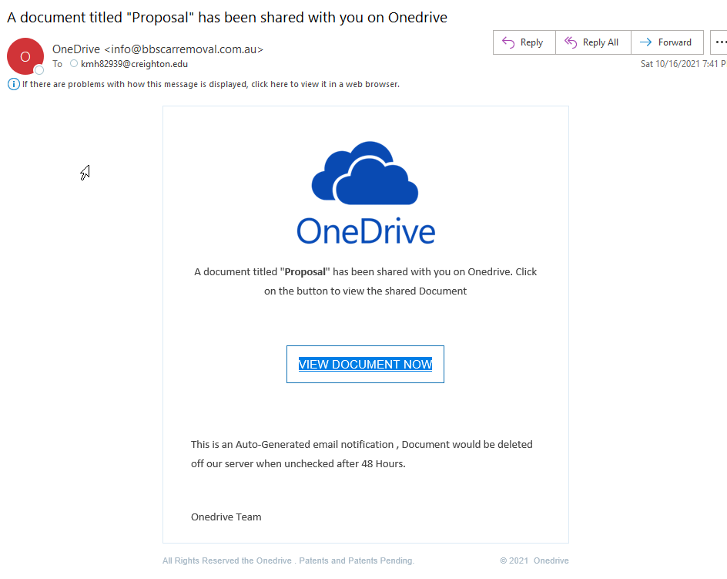
How to spot Phishing emails?
Suspicious Attachments/Links: use caution when you receive attachment unexpectedly.
Information Security

Slide 9
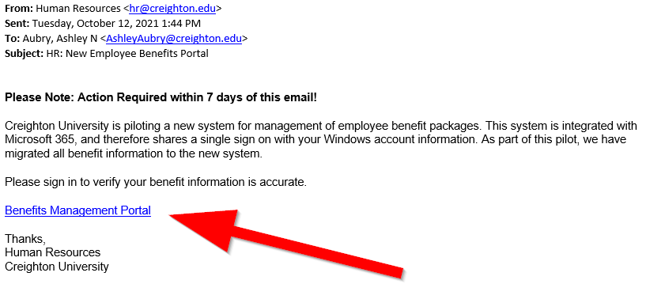
How to spot Phishing emails?
Information Security

Slide 10
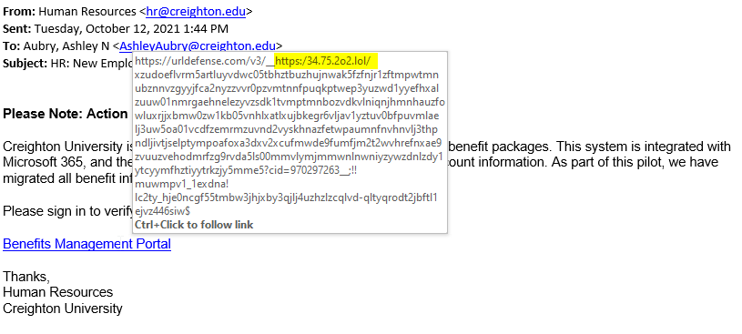
How to spot Phishing emails?
Information Security

Slide 11
How to spot Phishing emails?
Too Good to Be True: if it’s too good to be true, it’s likely untrue.
Information Security

Slide 12
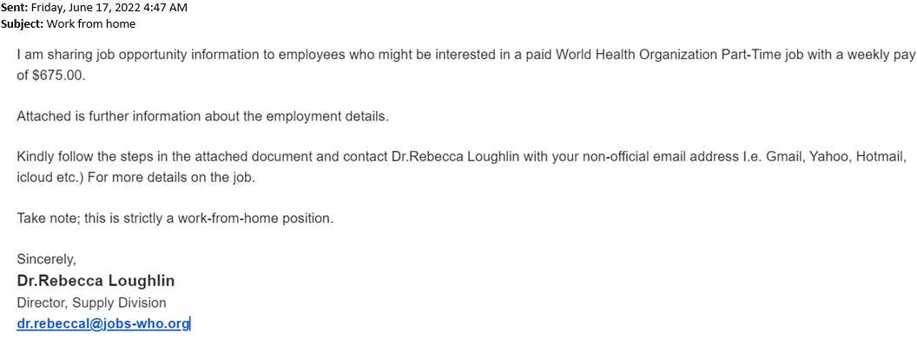
How to spot Phishing emails?
Information Security

Slide 13
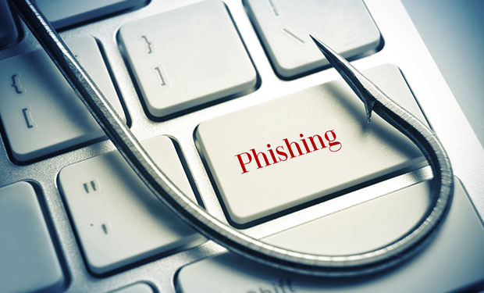
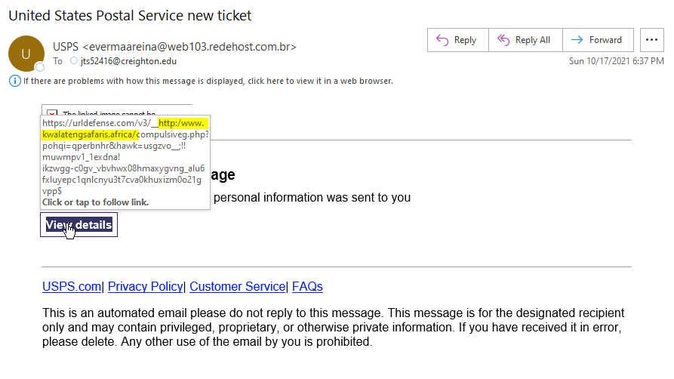
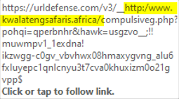
Information Security

Slide 14
Phishing Email?
Forward email to abuse@creighton.edu for evaluation
Call the person or department to verify message is legitimate
Don’t click on the embedded link in the email! Instead use the same method/website you use when accessing site.
Information Security
14

Slide 15
Microsoft Email Protection

Slide 16
Changes to Junk/Quarantine Email
Current Method
Information Security
16

Slide 17
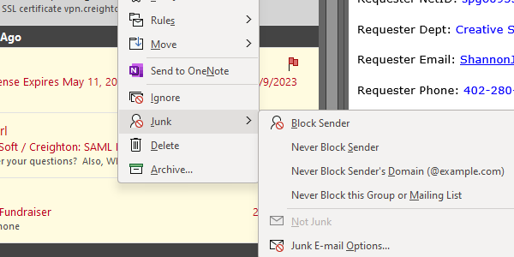
Changes to Junk/Quarantine Email
New Method
Information Security
17

Slide 18
Microsoft Authenticator App Update

Slide 19
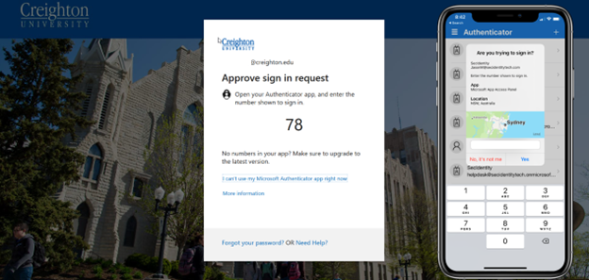
Microsoft Authenticator App Update
Information Security
19

Slide 20
Questions?
Information Security
20

